Slide 1
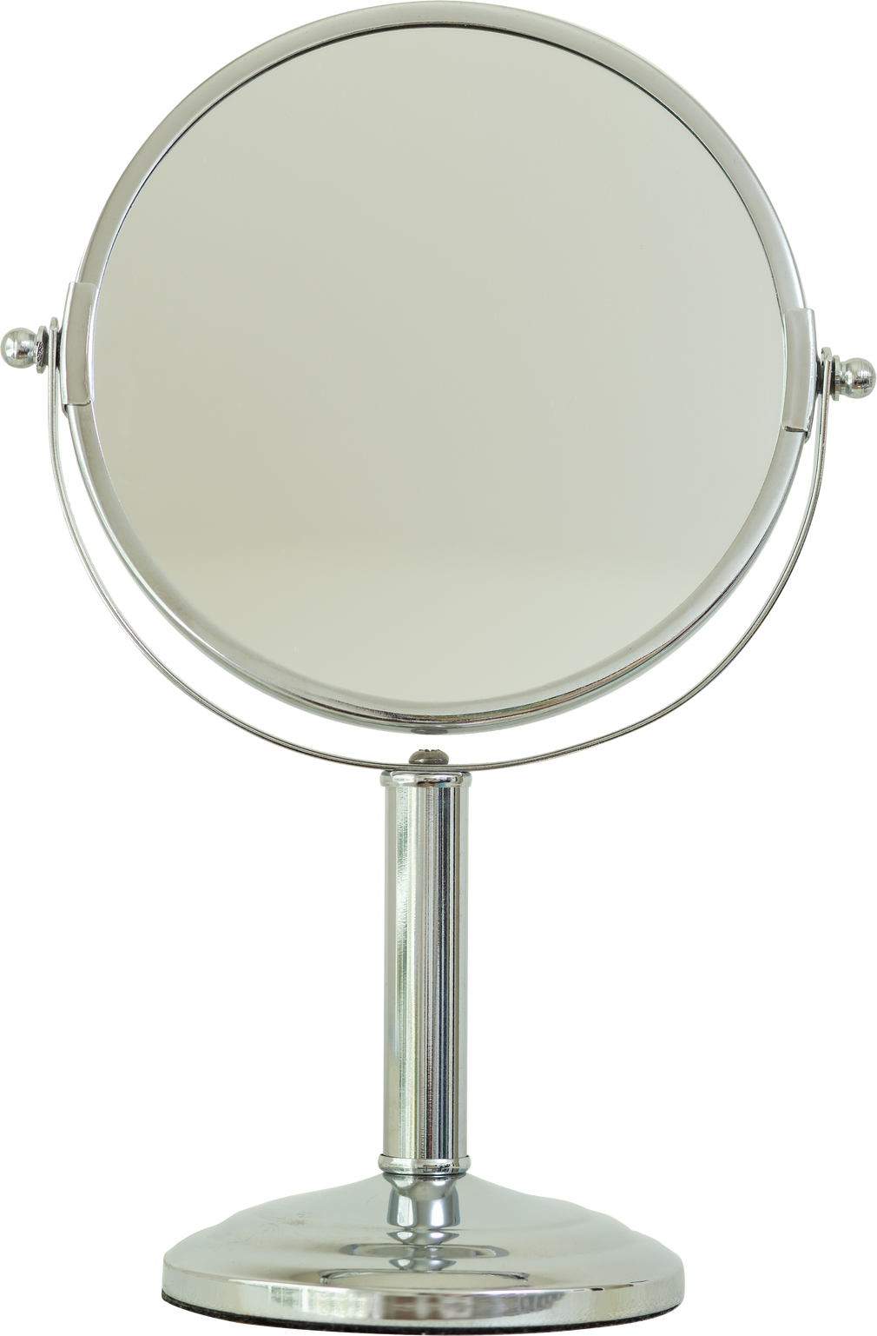
Visual Argument
“The Face of Beauty”
Cammy Hyde

Slide 2
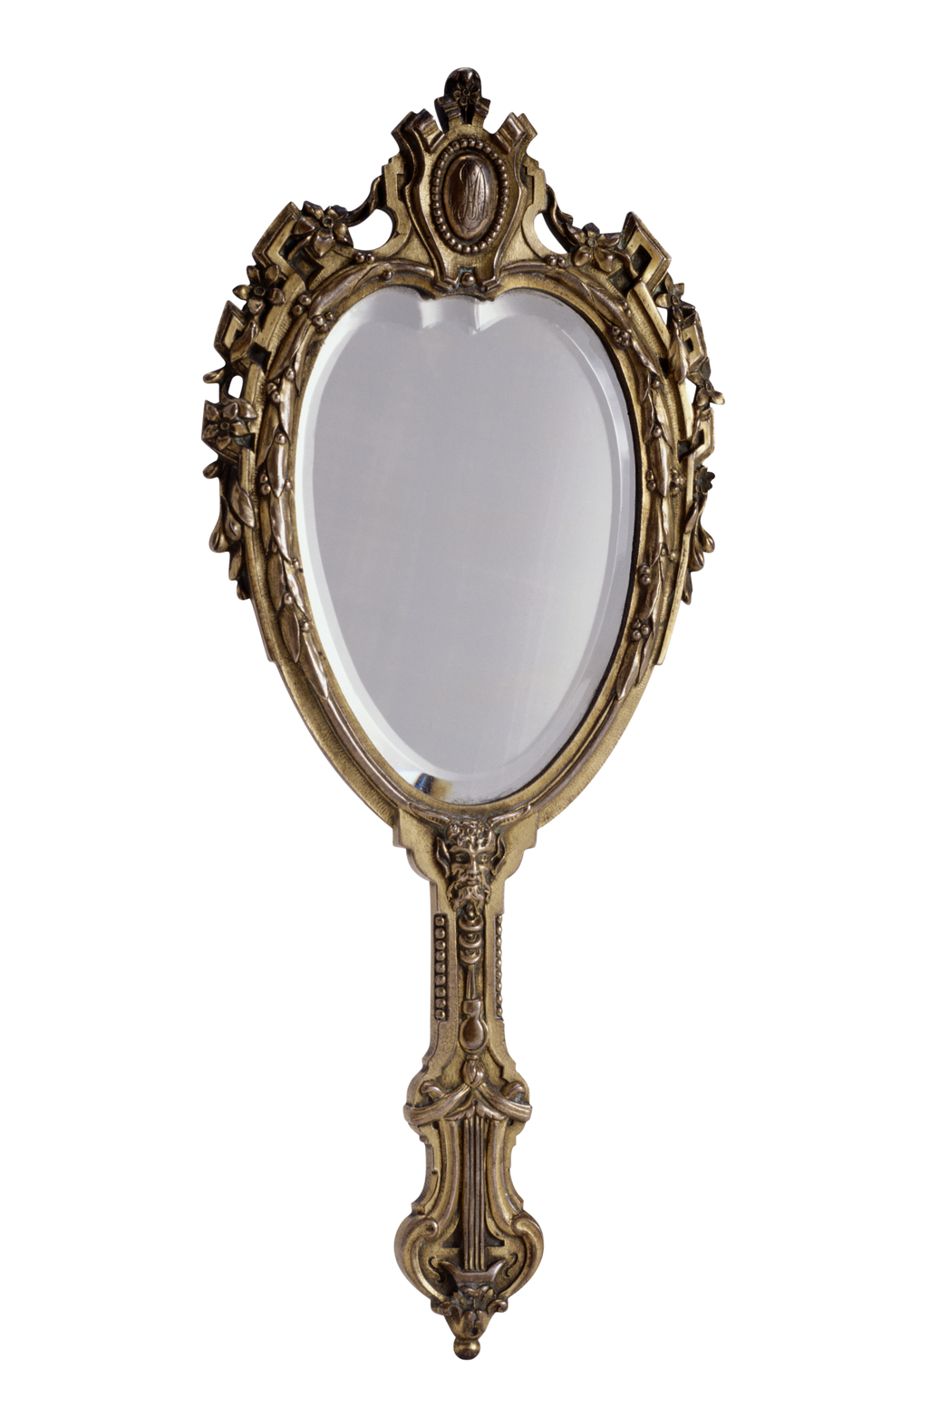
Table of Contents
Visual argument
Inspiration
Issues at hand
Target audience
Interests & attitudes
Resistance & challenges
Learning lessons
Recap

Slide 3
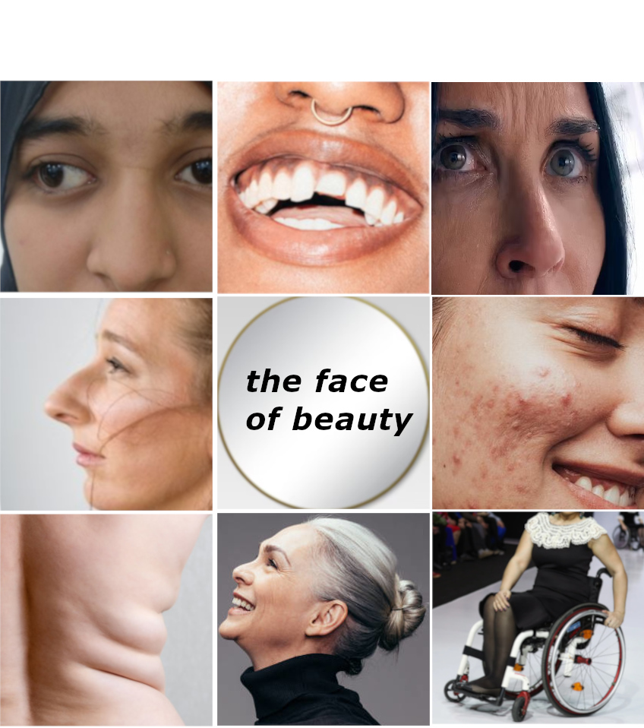
Title: “The Face of Beauty”

Slide 4
Crooked Teeth
Crossed eyes
Wrinkles
Crooked nose
Acne
Body rolls
Diabilities
Gray Hair

Slide 5
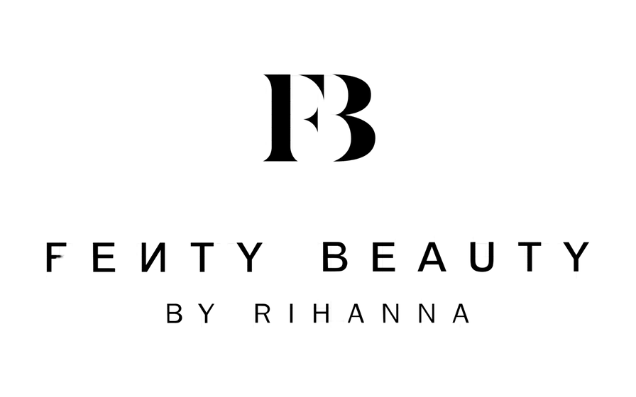

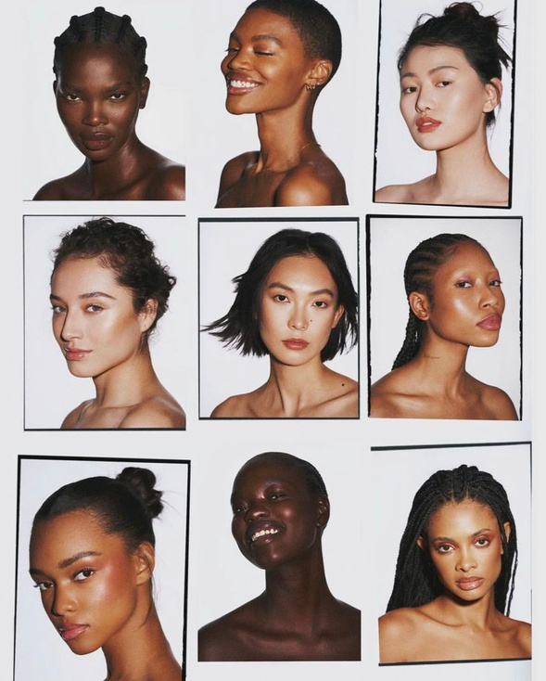
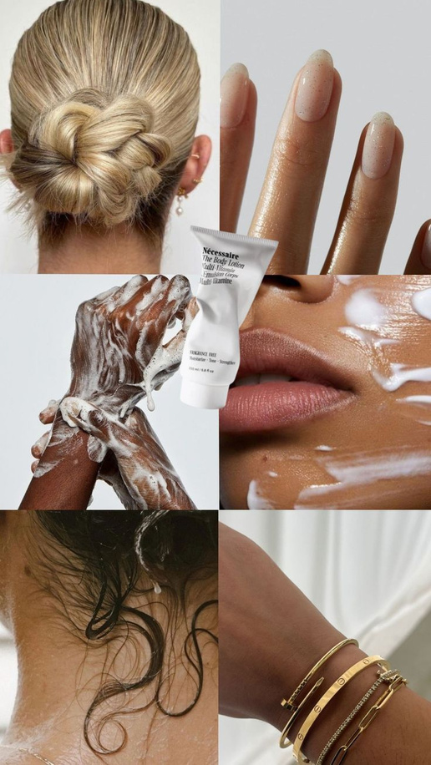
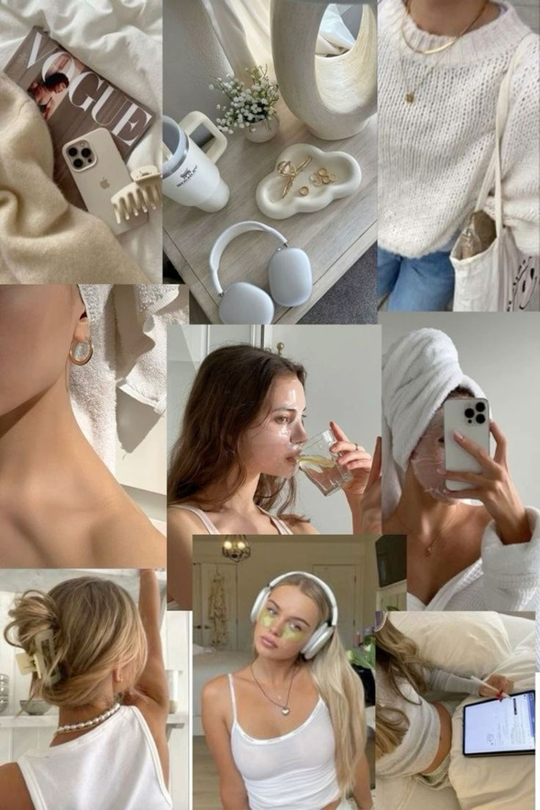
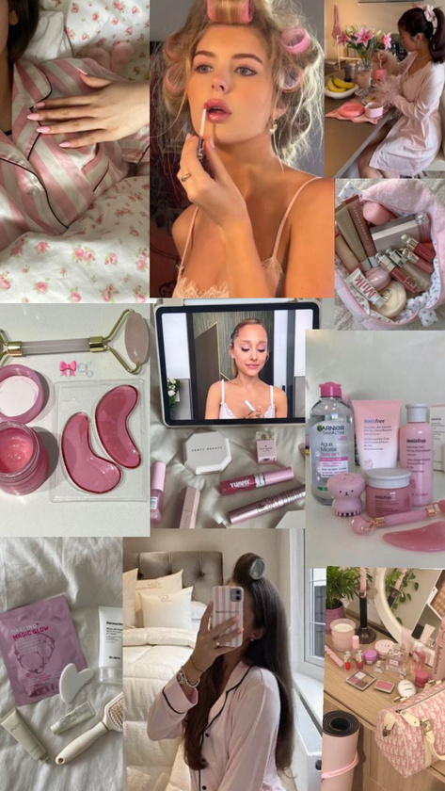
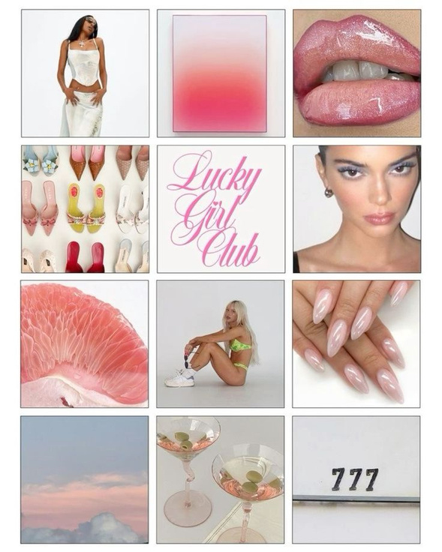
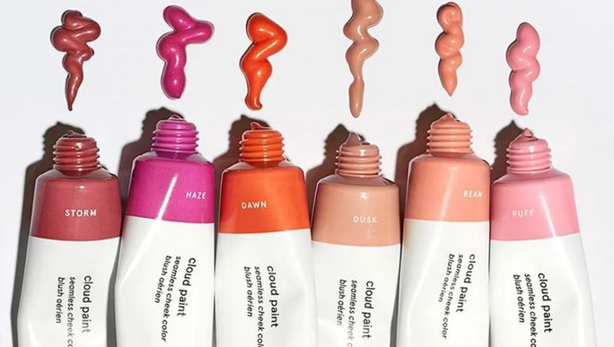
Inspiration

Slide 6
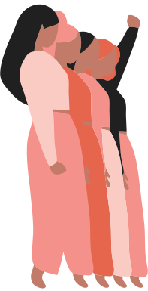
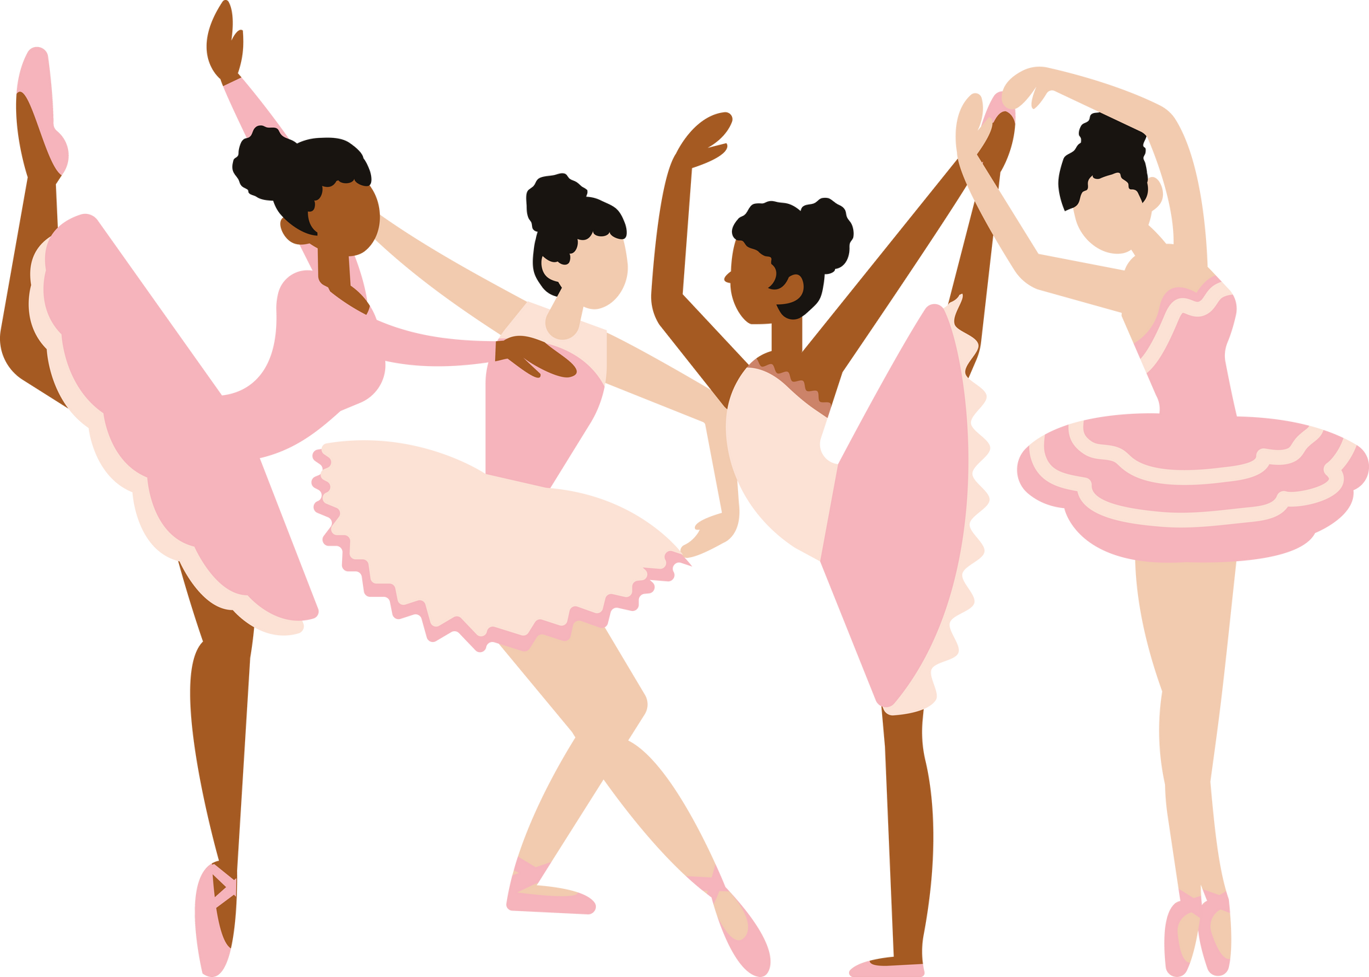
Target Audience
Girls & women in the U.S.,
ages 10 - 30

Slide 7

Where & Why?
Social Media
Instagram, Pinterest, X (formerly Twitter)
Beauty brand ad campaign
Product launches, company campaign for significant events
Billboards/street art
Publicly displayed so women everywhere can see it and internalize its message

Slide 8
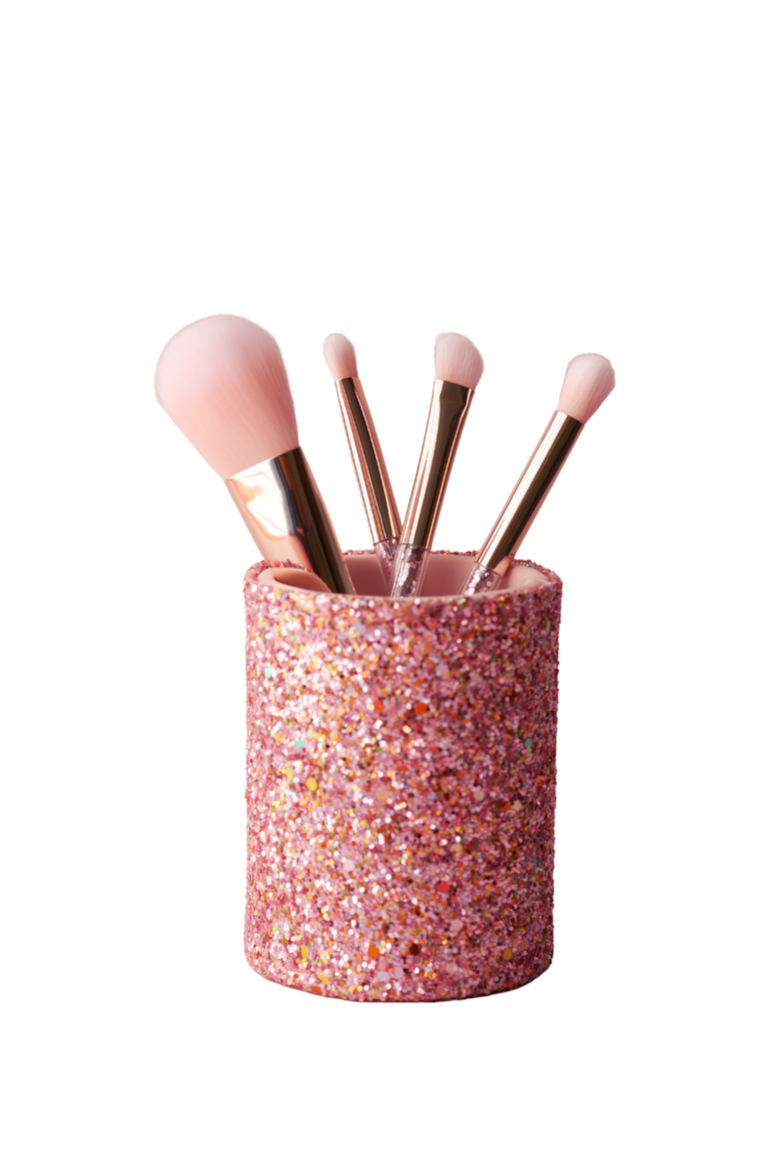


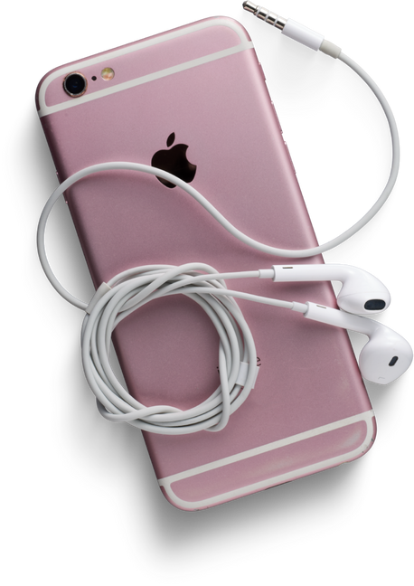
Interests & Attitudes
SOCIAL MEDIA
MAKEUP
FASHION
POP CULTURE

Slide 9
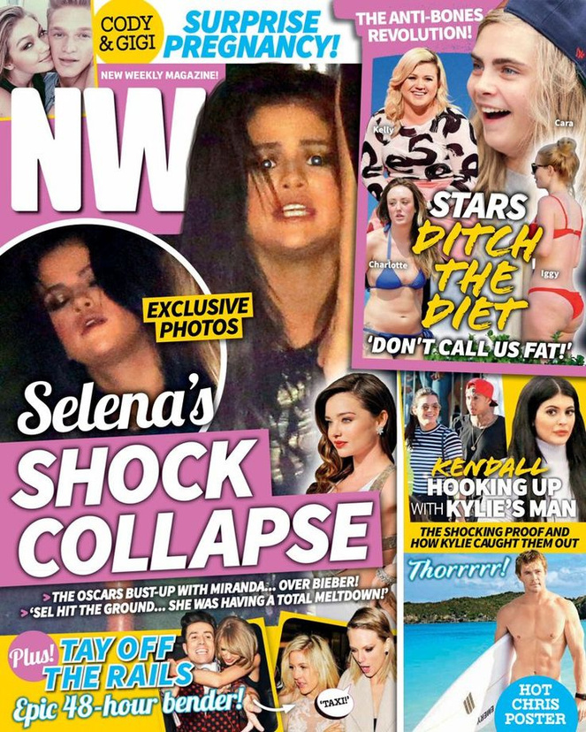
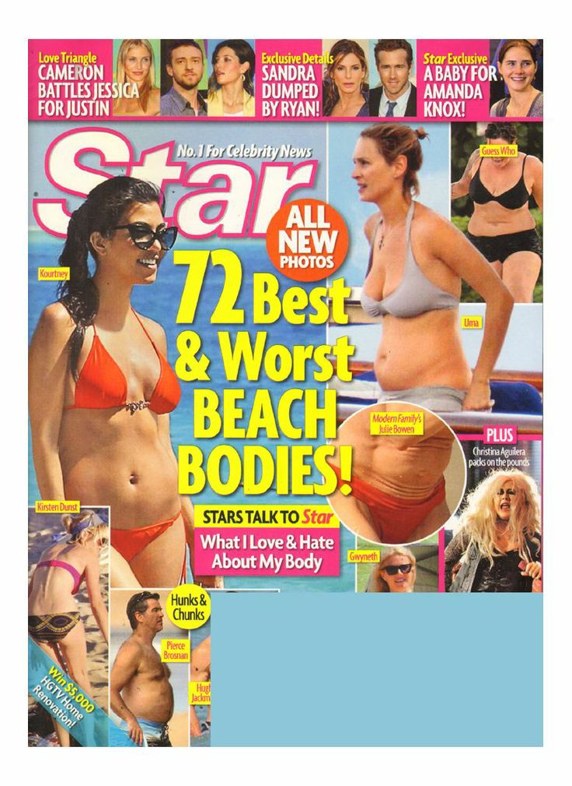
Resistance & Challenges
Women treated poorly by the media
Beauty standards perpetuated by pop culture & celebrities
Collective shaming of those who don’t fit beauty standards

Slide 10
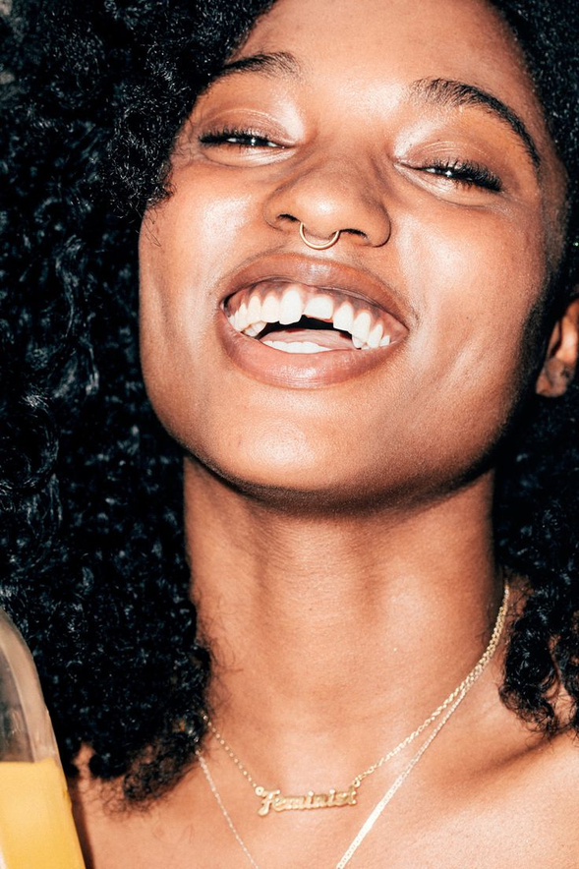
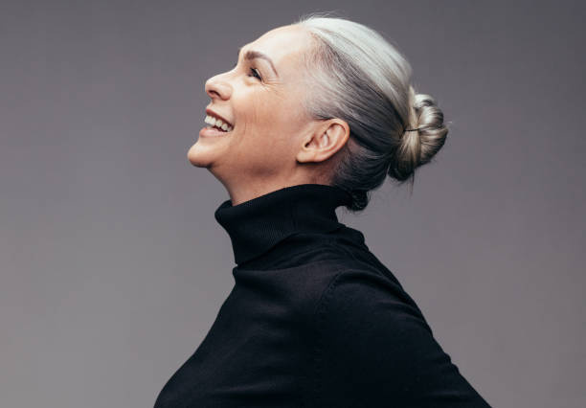
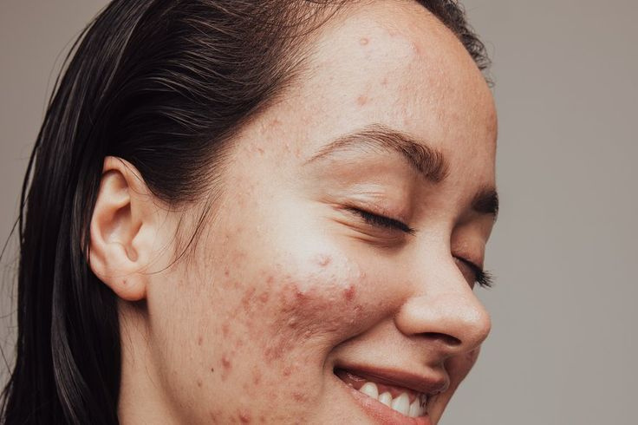
Learning Lessons
Incorporated smiling faces into project to convey a celebratory feeling
Kept the colors limited to skin tones and neutrals to keep that simple, clean, natural aesthetic

Slide 11
Recap
My target audience is young women in the U.S.
The project is meant to be on social media, beauty campaigns, and billboards.
The problem is strict beauty standards society holds women to
My project persuades viewers to accept and love their traits, even if they don’t fit into these harsh standards
It does this by showing women embracing their physical traits, maintains a clean & natural aesthetic, and urges the audience to question their own ideas of beauty

Slide 12
Thank You!

